Slide 1

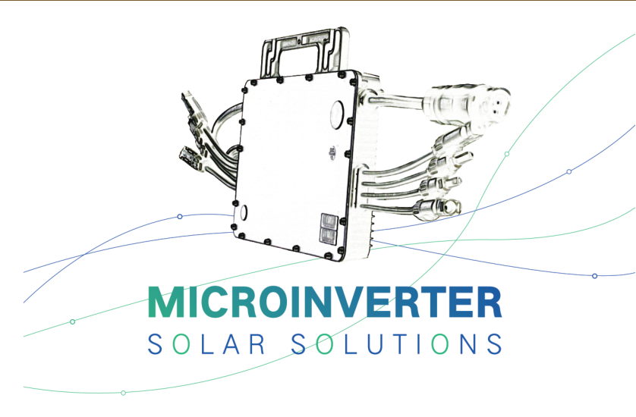
Hoymiles Introduction

Slide 2
catalogue
01
02
03
04
05
Company
R&D
Products
Services
Projects

Slide 3
PART 1
Company

Slide 4


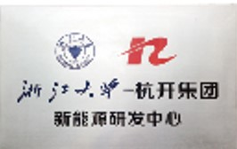



Rename
2012
Hoymiles Established
(Combination)
Hoymiles R&D team set up in National Key Power Electronics Laboratory
(Technology)
2008
Zhejiang University - Hangkai Group New Energy Technology R&D Center established
(Capital)
2010

Slide 5
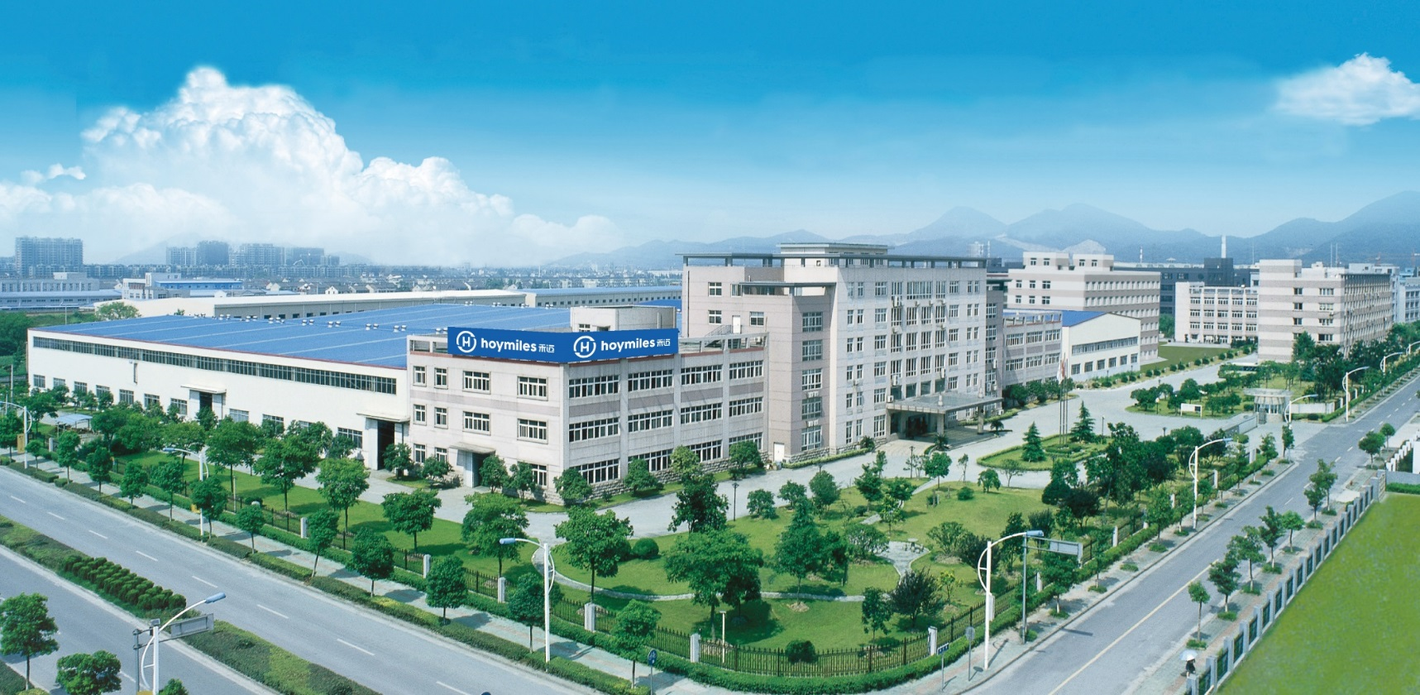







Hangkai Group Since 1958
(parent company)
Over 10 group members
Over 200,000 sqm factory
Over 2,000 employees
3 listed companies:
Hangkai Renewable Energy
(Stock code: 835561)
Lujie Water Technology
(Stock code: 837365)
Zhejiang Fangzheng Motor
(Stock code: 002196)

Slide 6
2018
New generation MI-1200 achieves the world's No.1 CEC weighted efficiency for 4 in 1 microinverter
Future
Hoymiles Milestone
Win the second prize of National Natural Science. Fully own 3 subsidiary companies.
2016
China installed over 50% of solar projects in the world with 53GW. And Hoymiles ranked no.1 for microinverter installation in China and became CSA authorized testing laboratory.
2017
Smart microinverter gains the certification of CSA, BV, SAA and CQC
2014
250W & 500W microinverters entered USA, Europe and Australia.
Over 10,000 rooftop projects installed with Hoymiles microinverter.
2015
Join the writing of national compulsory standard of the PV grid-connected inverter
2013

Slide 7
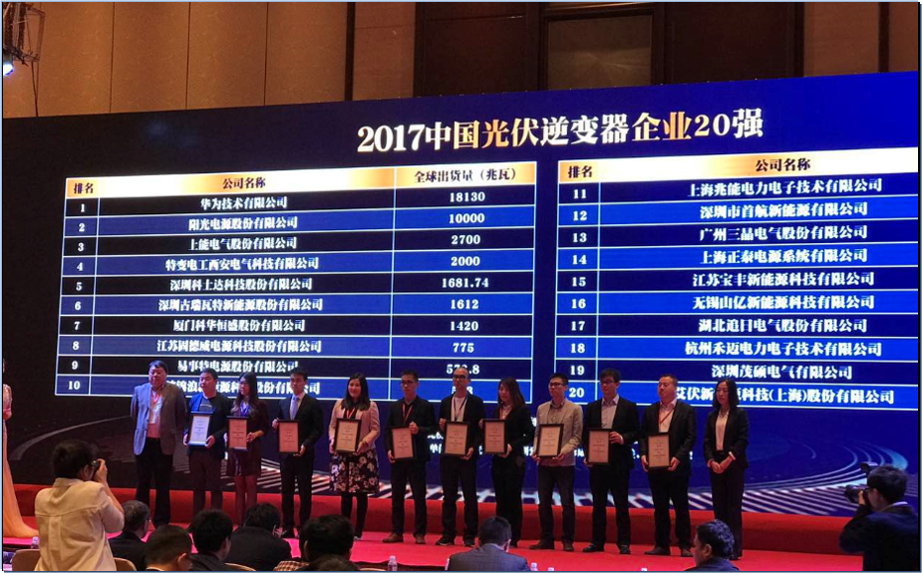
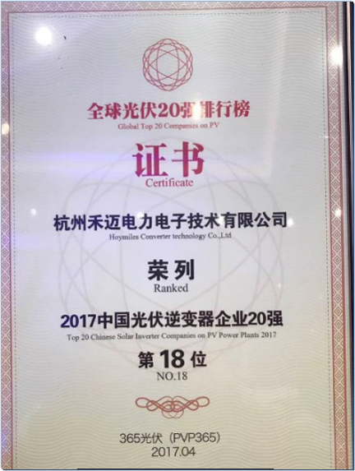
Hoymiles - Top 20 Inverter Company in 2017

Slide 8
Global Sales Network
Canada
Netherlands
Poland
UK
Germany
China
South Korea
U.S.A
Ireland
Italy
Turkey
Portugal
France
Japan
India
Headquarters
Mexico
Morocco
The Philippines
Malaysia
Sri Lanka
Brazil
South Africa
Mauritius
Australia
Chile

Slide 9
PART 2
R&D

Slide 10

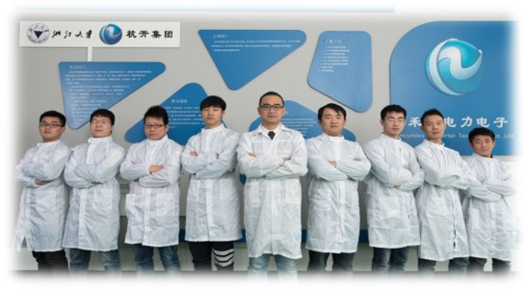
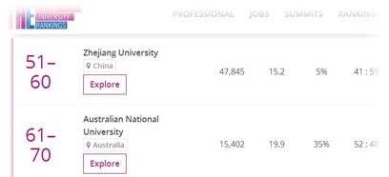
Hoymiles R&D Team
Members mainly from Zhejiang University
3 post-doctors
10 doctors
25 masters
One of the top 3 universities in P.R.China
One of the top 60 universities in the world
(Times Higher Education/QS World University Rankings)

Slide 11
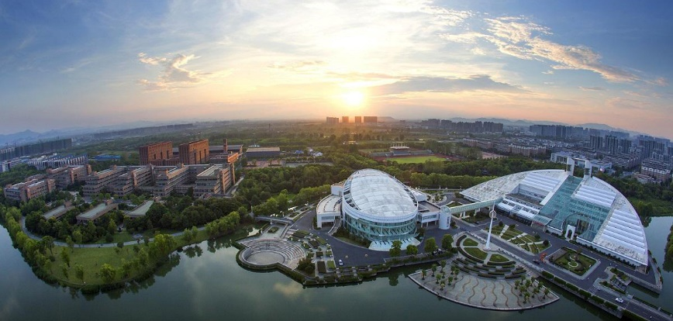
World Class Power Electronic Technology
National Key Power Electronic Laboratory

Slide 12
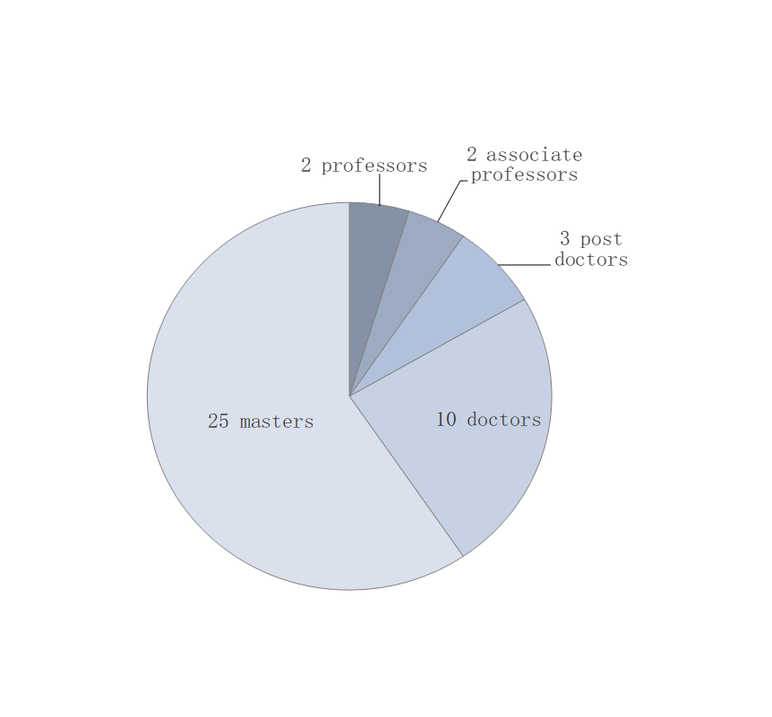
Talents
Cooperation
Projects
National 863 Program island wind and
solar power storage project
National 973 Program smart micro grid project
National Innovation Fund projects
National Natural Science Fund projects
Zhejiang Innovation Fund projects
Talent cultivation
Technical cooperation
Project cooperation
R&D center

Slide 13
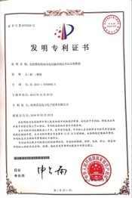
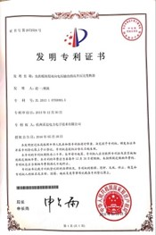

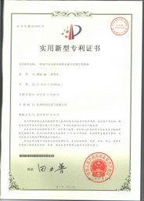
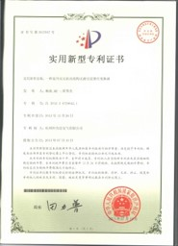
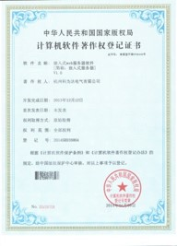
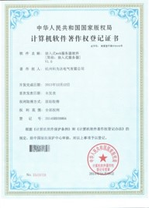



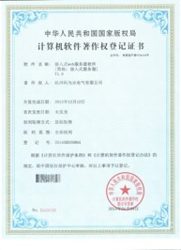

10 national patents
15 software copyrights
Over 10 SCI and EI papers

Slide 14

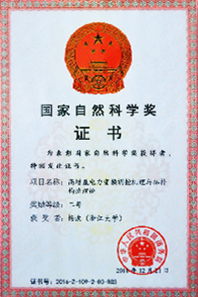
Second prize of national natural science
The 1st national natural science prize for power
electronics subject in China
The only national natural science prize for inverter
industry in China

Slide 15
PART 3
Products

Slide 16
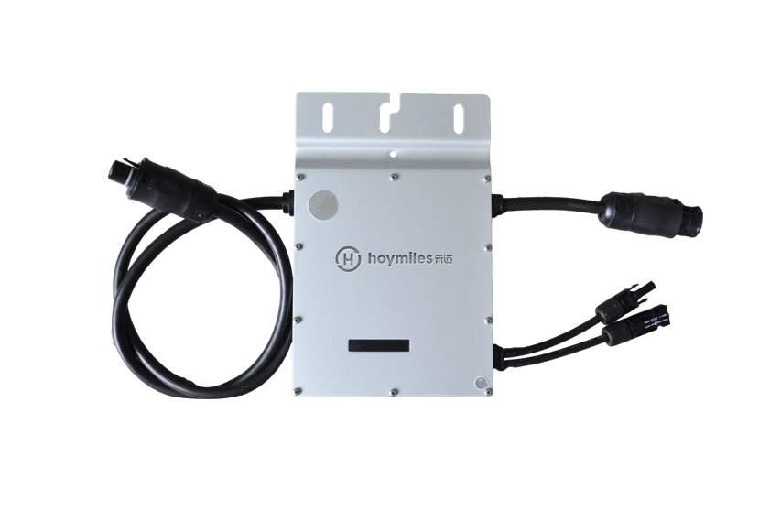
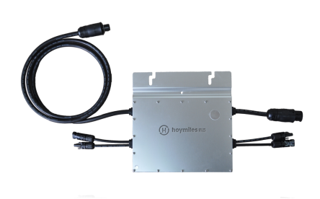
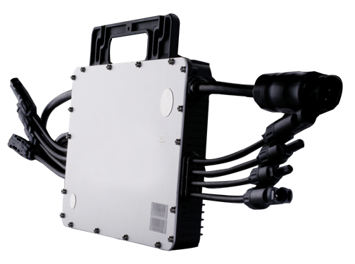
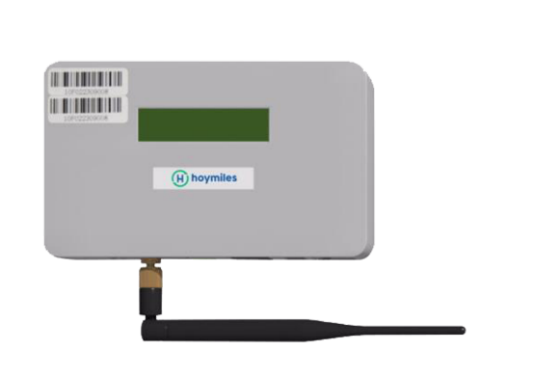
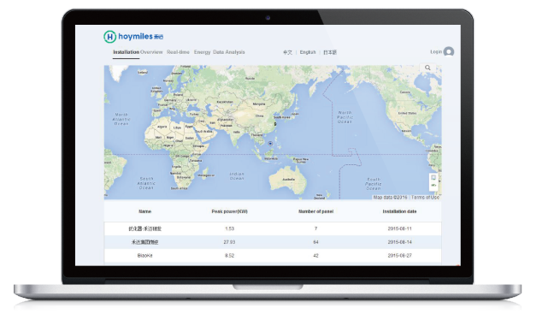
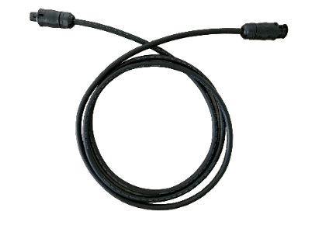
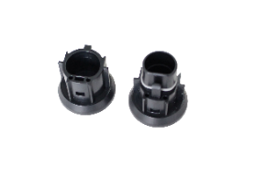
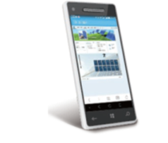
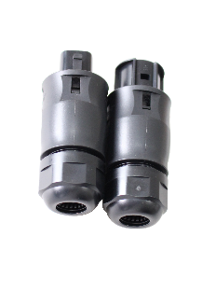
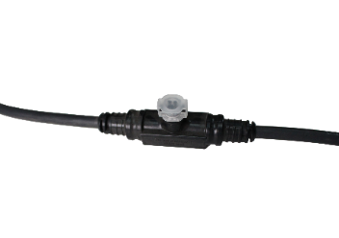
1
Hoymiles Microinverter
250W-1500W
MI-250/300/350 MI-500/600/700 MI-1000/1200/1500
DTU
Smart Monitoring
Accessories

Slide 17


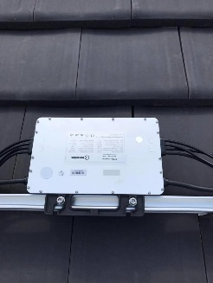
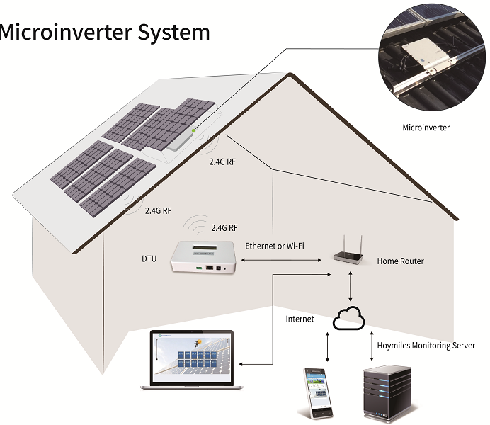




Highlights of Hoymiles MLPE microinverters
Safer
Smarter
100% safe up to 60V DC input voltage; Natural rapid shutdown
MLPE level monitoring;
Remote maintenance and troubleshooting
More Powerful
More Reliable
Module level MPPT to ensure 10-30%
more energy harvest compared with
string inverter
6000V surge protection; MTBF (mean time between failure) > 550 years;
Yearly failure rate < 0.18%;
Up to 25 years warranty
Simpler
Lighter
Less accessories;
One person’s work for installation
(saving labor costs);
IP67 waterproof for outdoor application;
Wider application environment (-40 ~ 65℃ )
Only A4 paper size;
3.75kg only for 1500W

Slide 18
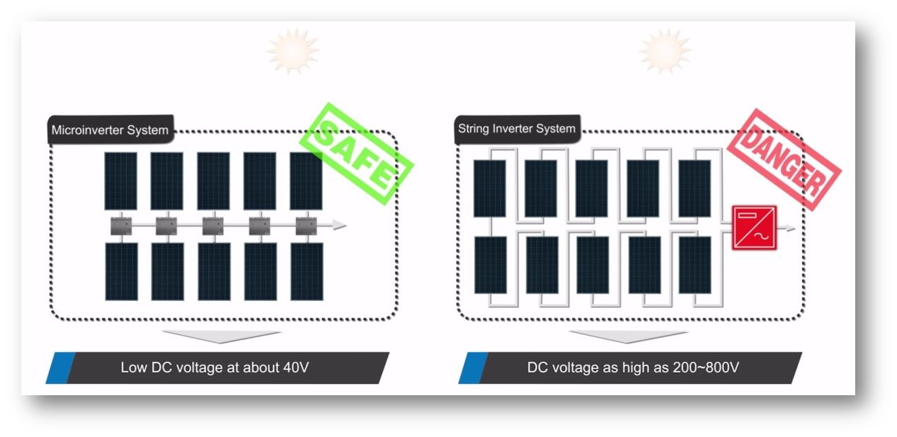
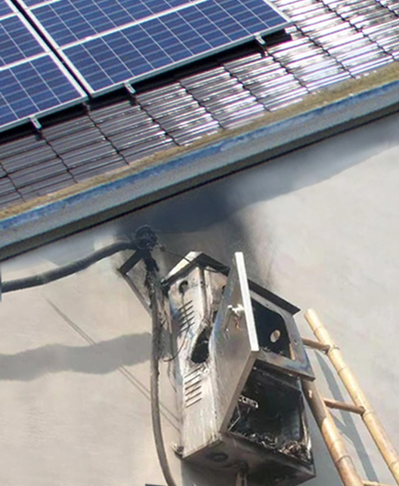
1. Safer - No fire risk and electric shock during installation and
operation due to low DC voltage(up to 60V) compared with at least
200V from string inverters
Zero risk for fire

Slide 19
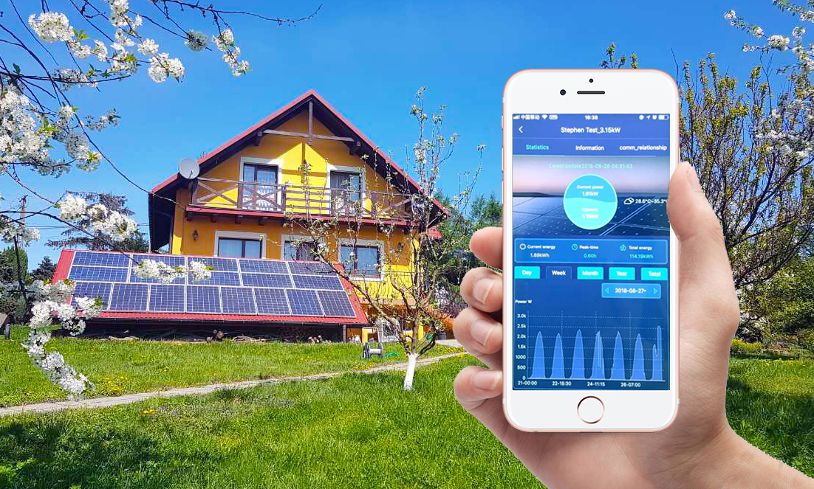
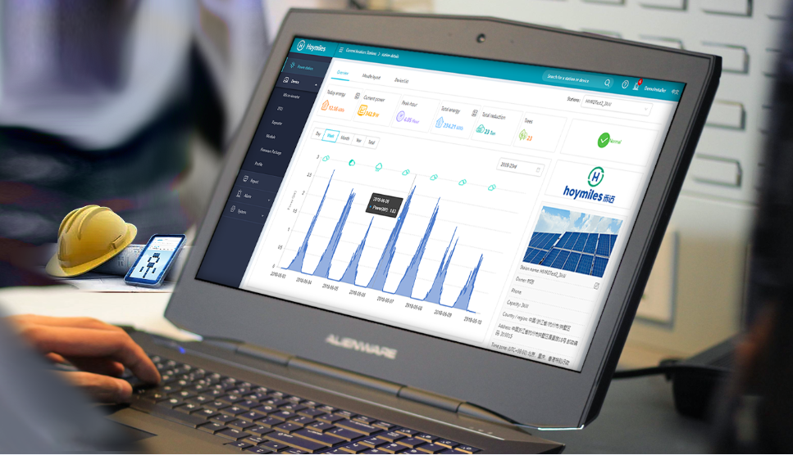
2. Smarter - Module level monitoring system; Remote maintenance and troubleshooting

Slide 20
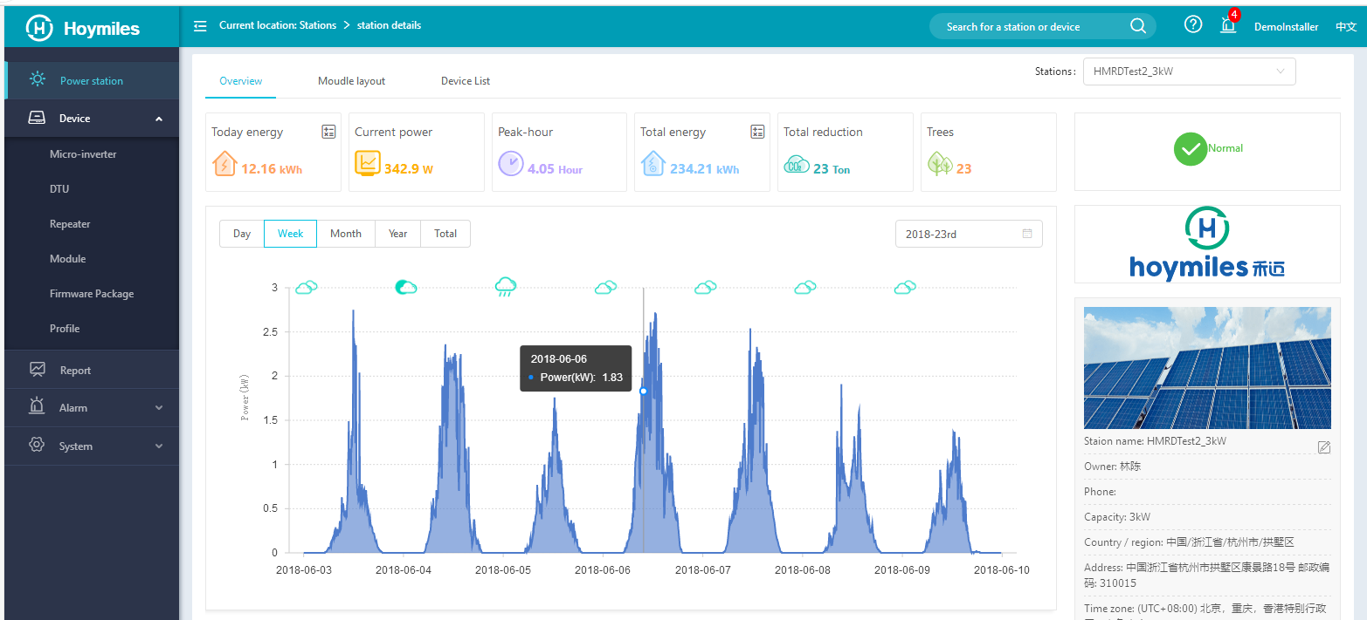
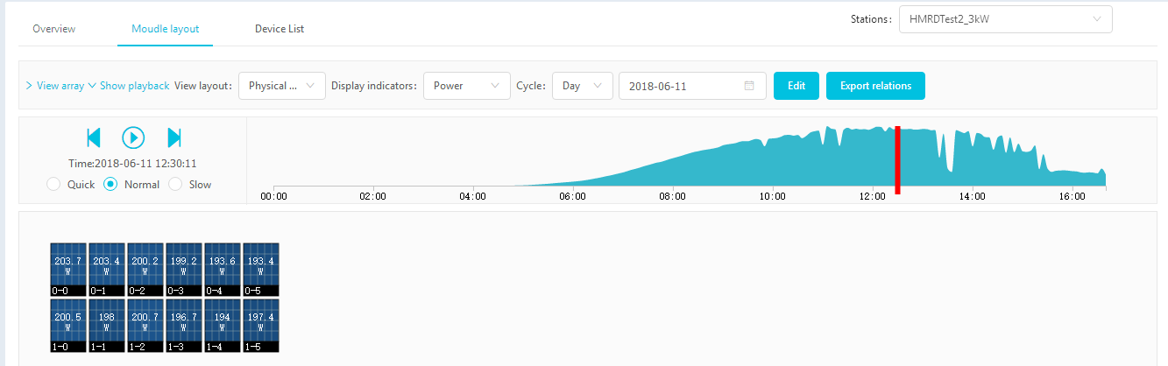
Key Features for Hoymiles Monitoring System
Module-Level monitoring
Allow customers to view the real time data of how microinverter operates with each solar panel.
Data transmission
Allow customers to download the operating report from the monitoring platform.
Remote upgrade
Allow installers to upgrade the microinverter's firmware remotely, so the service
maintenance is much more easier.
Breakpoint continuingly transmission
In case of malfunction of the home router, Hoymiles’ DTU will store 168 hours of data locally, and upload to monitoring platform once the
home router goes back to work. Therefore, customers will see continuingly data on the platform.
Remote reboot/shutdown
Allow installers to reboot or shutdown the system remotely,
in case it is required during the maintenance.
Multiple methods to achieve online monitoring
Wi-Fi, Lan or GPRS is optional, thus monitoring based on local
conditions is realized.

Slide 21





World’s No.1 CEC Weighted Efficiency of 96.5% since 2015
3. Higher generation
- Module Level MPPT achieved the highest power output, avoiding the Cask Effect like what happens to string inverter, which the performance will be limited by the weakest performing panel.
50% 100% 100% 100%
50% 50% 50% 50%
MLPE Microinverter
String Inverter

Slide 22
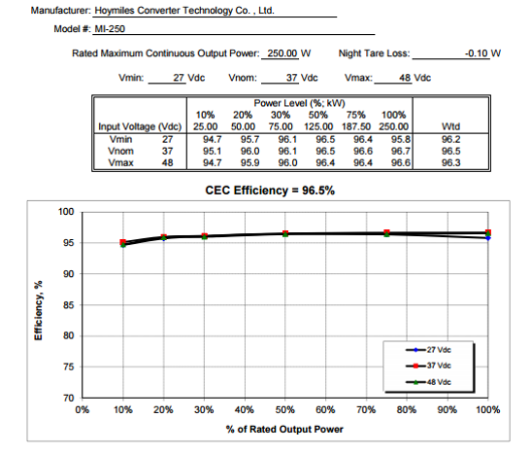
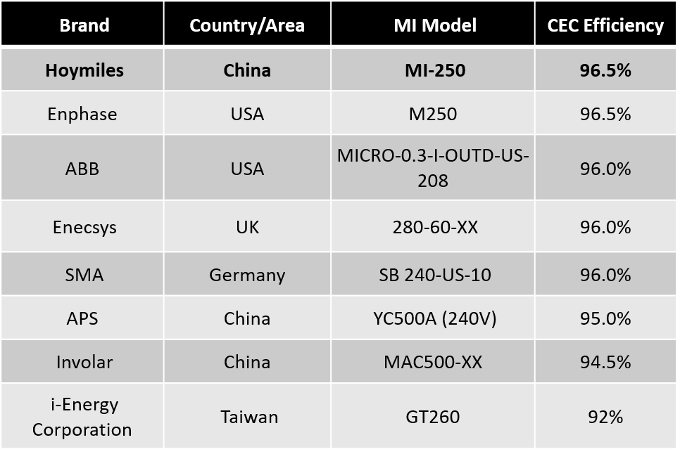
Third Party CEC Official List
World’s No.1 CEC Weighted Efficiency - 96.5% for microinverter
- since 2015
http://www.gosolarcalifornia.ca.gov/equipment/inverter_tests/summaries/

Slide 23
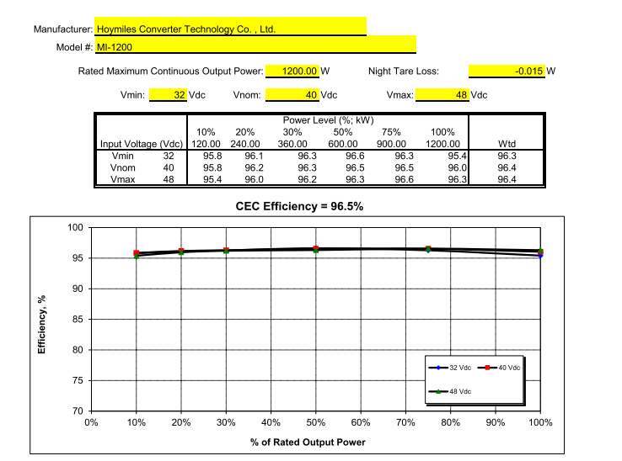
World’s No.1
CEC Weighted Efficiency for 4 in 1 Microinverter （MI-1200) - 96.5%

Slide 24

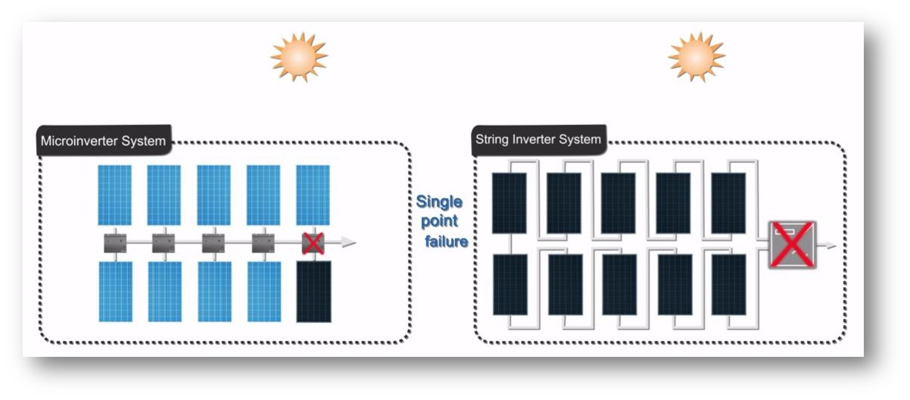
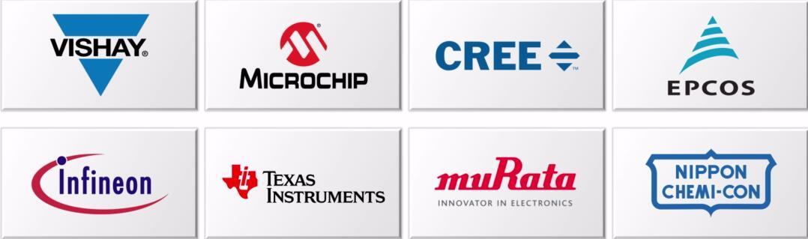
4. More reliable
World top class brands for key components;
No single point failure, one inverter’s failure will not impact the total system working;
IP67 enclosure design
Longer warranty: 12-year standard warranty and 25-year extended warranty, much longer than string inverters’ 5-year warranty

Slide 25
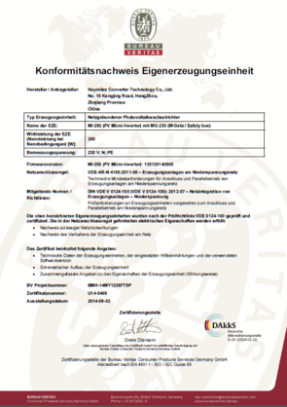
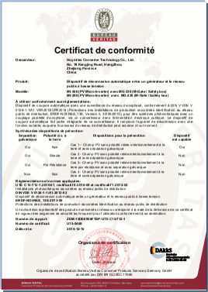
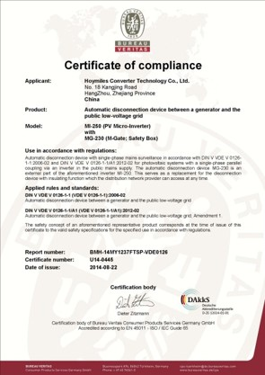
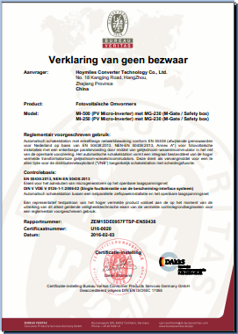
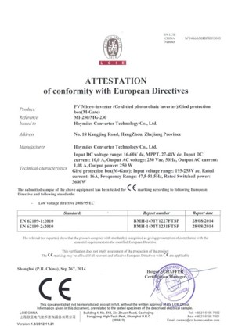
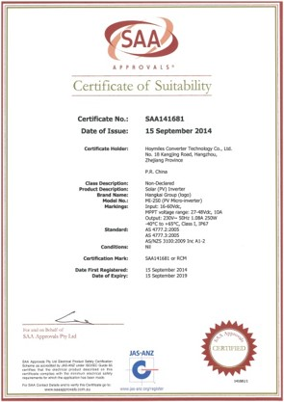
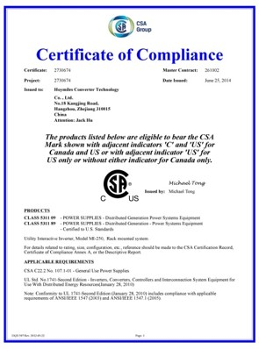
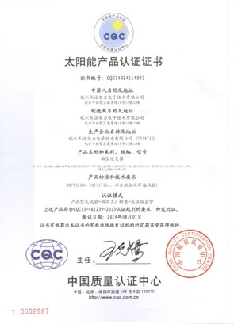
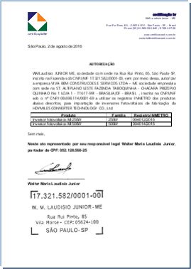
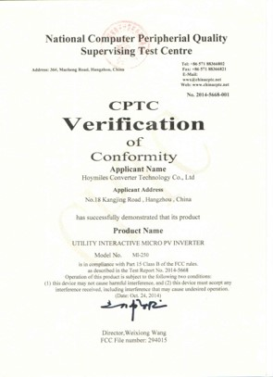
Europe
VDE4105 VDE0126 EN50438 VFR2014 CE
Australia/Israel
SAA
USA
CSA FCC
China
CQC
Brazil
INMETRO

Slide 26
PART 4
Services

Slide 27






System Design
We provide customized service to customers in
terms of system design of PV power station, the implementation, equipment selection etc.
Hotline Service
Customers can reach us by the hotline in case of any equipment failure. The service is available 24/7.
On-site Service
If the problem can’t be solved via hotline, engineers will be sent to the site within 24.
Regular Return Visit
Our after-service staff will give one return visit in the minimum annually within the warranty.
Customer Training
We provide timely on-site training programs according to varied
requirements to share the specialized knowledge and rich experience.
Customized Service
Customized service and corresponding agreements are available to meet the specific needs of customers.

Slide 28
PART 5
Projects

Slide 29

Quzhou, Zhejiang PV Farm 30MW (2016)

Slide 30


Jiangsu Fremantle Lighting PV System 2MW
Hangzhou Amplesun Lighting PV System 1MW

Slide 31


Hoymiles PV Project in Kecheng
63 Residential Rooftops
Hoymiles PV Project in Qujiang
500 Residential Rooftops

Slide 32


Floating project in Quzhou 1.5MW
Industrial project in China 3.6MW

Slide 33


Industrial project in South Arica with
Hoymiles microinverter MI-600

Slide 34


Monterrey, Mexico
Residential Solar System
Commercial project in Cuba 100kW
Gas Station project in Brazil 26kW

Slide 35


Commercial project, McDonald's
in Ukraine 30kW

Slide 36


Residential project in Poland 3kW
Commercial project in Poland 12kW

Slide 37


The biggest commercial installation
in Eastern Europe 63.6kW

Slide 38


United States
Hoymiles Microinverter Solar System 5kW
United States
Ground Solar Plant with Hoymiles Inverter

Slide 39
END
THANK YOU
World leading MLPE PV inverter brand

