Slide 1
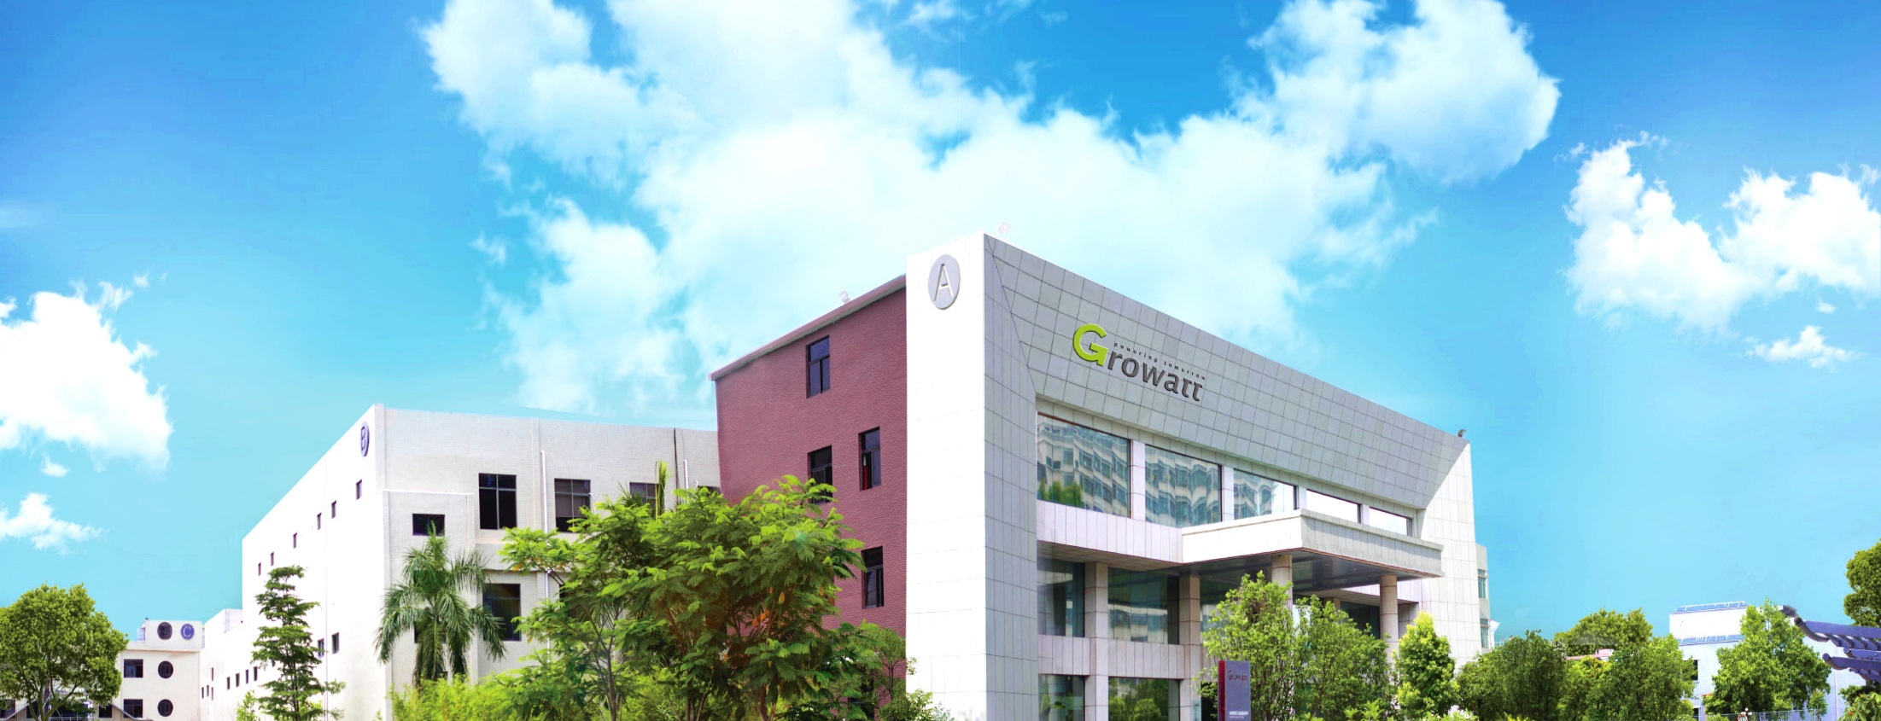

Growatt
Notes:
Good XX, everyone, My name is XX, please give me few minutes to make a presentation for you so that you can know more about us.

Slide 2



Conteúdo
1
Introdução
2
Capacidade
3
Soluções
4
Filiais
5
Serviços & Treinamento
6
Referências Globais
Notes:
There will be six parts of my slices, “who are we?””what we are good at””what we can offer”, “how big are we”,”what support we provide” “Reference”
………………
建议不讲以下内容，耽误时间：
(
Introduction: It consists of Growatt Motto, Milestone, certification, Shipment capacity.
Strengths: It includes R&D development, leading-edge technology, TUV certification.
Solution: Growatt provide solution for residential, commercial & utility and storage system, including monitoring and maintenance solution (Shine Phone, Shine Server, OSS)
Overseas Branch Offices: Brief introduction about the global presence in 14 countries including Europe, America, Australia, and India, etc.
Services & Training: Our services are more customer-oriented. We provide customized training, Service support 24/7 by our well-experienced team and Global service network to provide on-demand and online support. Shine Elite program designed to train and spreads PV knowledge, and share & exchange the industry experience.
References: It includes our worldwide experience for different types and capacities.
）

Slide 3

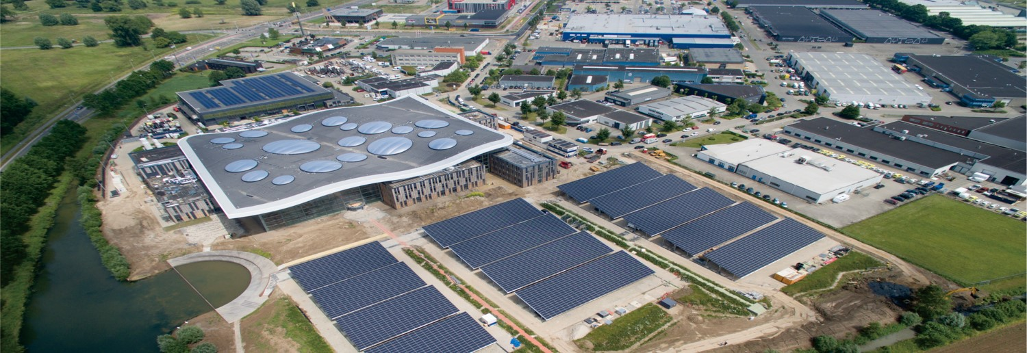
Introdução
1
Notes:
Let’s begin with the Growatt Introduction，the first part I will give you some basic information about the company.

Slide 4





Growatt
Growatt – Powering Tomorrow
Inauguração
Qualificação
Valor
Soluções
Experiência
Fundada em 2010, Capital registrado de 20 Milhões USD
Experiente equipe de P&D
National High-Tech Enterprise
Focada em inversor solar, liderança em Soluções de energia inteligente
Inversores instalados em mais de 100 países.
Notes:
Our company was founded in 2010 with 20million USD, we have an experienced and professional RD team, our concentration is and always will be “Inverters and Smart Energy Solutions”. With ten years developing, we are now a National High-Tech enterprise. Our inverters and smart energy solutions are widely used for both residential, commercial and industrial solar system from 750w-100kw capacity, now our products have been used for more than 100 countries, we always focus on user side application, through our advanced inverter and smart system, we are able to help more than 1.8 million sites to use their green energy smartly and significantly reduce the carbon emission for more than 10 million tons.

Slide 5



Growatt Motto
Growatt – Powering Tomorrow
Visão
Dedicação em promover soluções inteligentes de energia
Missão
Valores
Prover um acesso conveniente a energia verde.
Inovação
Excelência
Foco no cliente
Notes:
With the dream of a green world, Growatt takes the mission of providing clear and convenient access to green energy. Growatt is a customer-focused, quality-focused and innovative company. With ten years’ development Growatt is more closer to the vision of becoming a global leader of smart energy solutions for end users.

Slide 6




Equipe
Empregados
Vendas e Engenheiros de serviço
1200+
260+
2020
Operadores de manufatura
Engenheiros P & D
200+
700+
Notes:
To support our vision, we have a well-qualified team. Today our company employs more than 1,200 employees worldwide. We insist on innovation and quality, therefore, our RD department has more than 200 experienced engineers are divided into 4 big teams as Grid-tied, Off-grid, Energy Storage and Intelligent Control Division. Our sales & service team has people more than 260+ around the world to provide the regional customer service, the rest are operators, more than 700.

Slide 7





Milestone
A Top 3. em inversor PV mono-fásico pela IHS Markit
2019
Top 10 mundialmente in IHS ranking por Exportação
EUPD Netherlands top brand
2018
2017
1.3 milhões de inversores enviados mundialmente
Conquista! Double A+ da Photon Lab com 99.03% eficiência
Investimento do Sequoia Capital
2014
2015
2012
A Top 5 Chinesa em inversores exportado
2013
National High-Tech Enterprise
Fundada em Shenzhen
2011
2010
A No.1 Chinesa em inversor exportado
Notes:
Here are some momentous occasions for our company. （自行根据需要选取重点）
The company was founded in 2010 and In the same year, we become China’s No.1 inverter export enterprises.
After that, in 2012 we got the investment of Sequoia Capital and China merchant
In 2013, with this investment, in the following two years, our company had become a National High-Tech Enterprise and in 2014 and awarded with Double A+ evaluation from Photon Lab with efficiency up to 99.03% global rank NO. 2.
The product has already been successfully mass-produced and based on our steady development in overseas markets, in 2015 we became the TOP5 inverter supplier in China.
In 2016, China's distributed market began and we reached more than 30% of market share of household inverters and becoming the china largest supplier.
In 2017, we are in the global Shipments of more than 1 million sets We are in the IHS Markit year of 2016, 2017, with share of 12 billion, which is around a rough estimate and our shipment entered the TOP10 supplier and we were also recognized by EUPD in the Dutch market Top inverter brand in the same year.
With the growing motto, based on the sale in the global home inverter market in 2018, we got the market position of No. 3 of single-phase PV inverter by IHS Markit after the Solar Edge and SMA. While we continues to get recognition in Europe, after EUPD we becomes the Netherlands and Belgium’s TOP inverter brand honor.

Slide 8





Investimento
Somos a unica empresa solar com investimentos da →
Notes:
Got investment from Sequoia capital in 2012 and China merchant in 2012 of
100 million USD. In china we are the only solar company who got the investment from Sequoia.

Slide 9
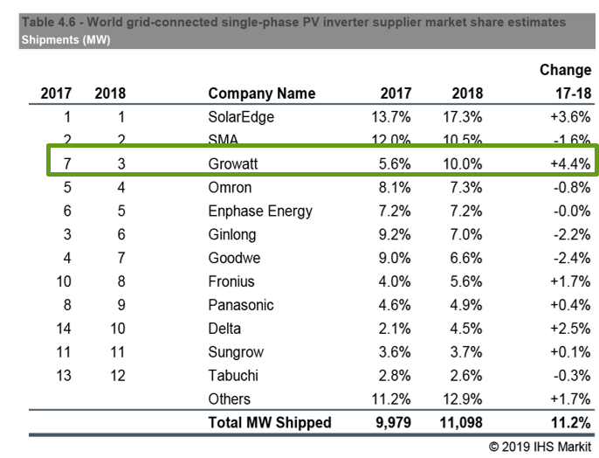
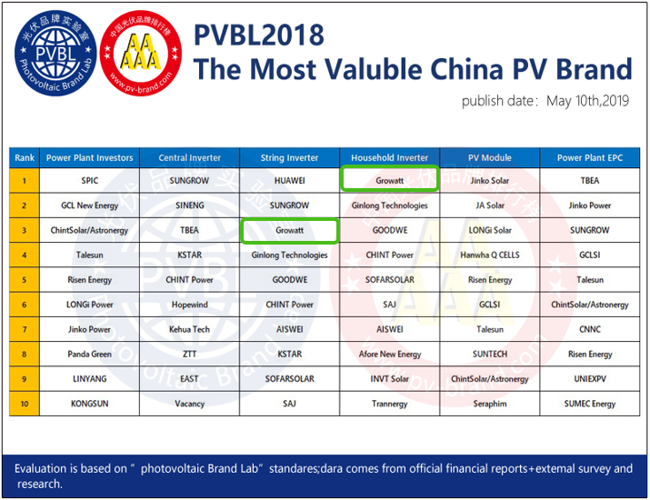
Conquistas
1
IHS Markit 2018 single-phase PV inverter Rank No. 3 Globally
2
Growatt No.1 em inversores residenciais na China PV Brand Ranking 2018
Notes:
According to the statistics of the IHS, we ranked 3rd globally in single-phase PV inverters in 2018 and we are very next to Solar Edge and SMA. In the same year, we ranked as 1st residential inverter brand of Chinese inverter brand ranking 2018.

Slide 10




Conquistas
EUPD TOP BRAND PV INVERTER Austrália & Holanda em 2020
Notes:
Growatt has cultivated the European market for many years, we are now the top brand of Netherlands and Belgium. These are the award from EUPD.

Slide 11

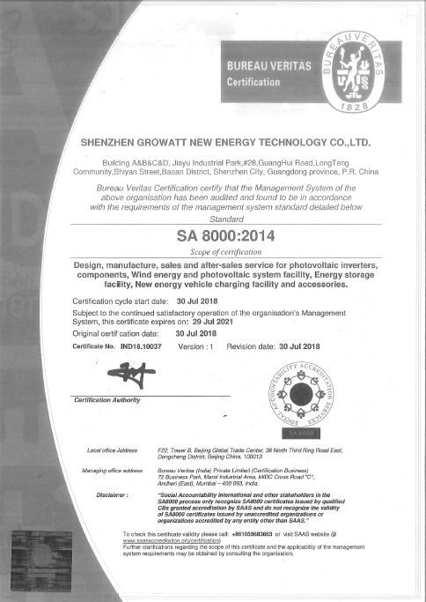
Compromisso social
Growatt dedica-se à responsabiidade social corporative desde 2010.
Adotamos práticas responsáveis no local de trabalho e conquistamos o certificado SA8000.
Notes:
Only Growatt have this certificate in China from Social accountability international.
The SA8000® Standard is the leading social certification standard for factories and organizations across the globe. which means that we are not only a company focused on products and business, we are also a socially responsible company
In china, in solar area only HUAWEI and Growatt got this certificate.

Slide 12
Capacidade
1,700,000+ Inversores enviados mundialmente.
7.5GW
Capacidade de produção
5GW
3.3GW
2018
2019
Meta 2020
Notes:
When it comes to our global shipment, we have been as No.3 residential inverter supplier globally, we have made more than 250,000 inverters running more than 5 years. In 2019, we aim to ship over 5GW capacity inverters and this target is achieved. With Huizhou New manufacture center establishment our target for 2020 is 7.5GW, It is clearly that our company is experiencing rapid growth, with an average annual growth rate of over 30%

Slide 13













Parcerias Globais
Notes:
Our partners in globally include many big energy company and even the government（整理最新大客户）
(自行选取重点）
EA→ Thailand’s large integrated new energy company, solar, wind power, EV car, Li-battery, etc , the boss is Top 10 Fortune list in Thailand, Growatt supply inverters for 2 of 90MW solar projects for EA
Royal Thai Airforce----Thailand, Growatt supply for 19 islands for 1.9MW storage system
Austra Energy---Top 10 solar distributor in Australia
Segen----Top1 solar distributor in UK
SolarClarity---Top2 solar distributor in Netherlands
Omnisun----On behalf of Growatt Italy, only sell Growatt inverters
EU-Solar---On behalf of Growatt Hungary, responsible to sell Growatt inverters
TATA --- One of the leading solar company in India
Foxconn --- Taiwanese multinational electronics manufacturing company

Slide 14
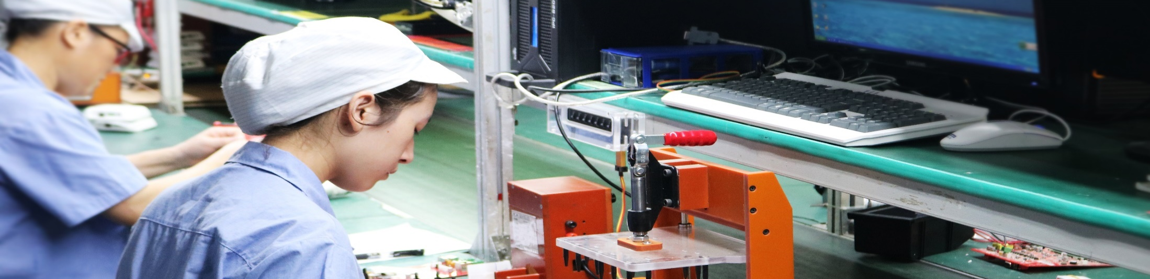
Capacidade
2
Notes:
Here are the Growatt strengths that makes us one of the leading PV inverter manufacturer.

Slide 15
Competência
Experiente P&D
Fábrica avançada
Globalização
Ciclo de qualificação dos produtos
Notes:
Growatt is a R&D Driven company, In Growatt R&D plays an extremely important role in new products, every year, more than 10% of income will go to RD, therefore, our smart energy solutions are designed by experienced industry insiders to meet the demands of different countries, our high level Manufacturing centre ensures we can make cutting-edge technology and high quality product based on our outstanding assembling line and well-trained operators.

Slide 16
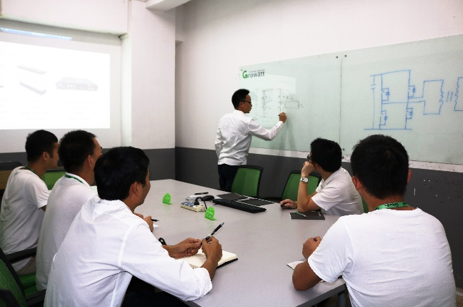
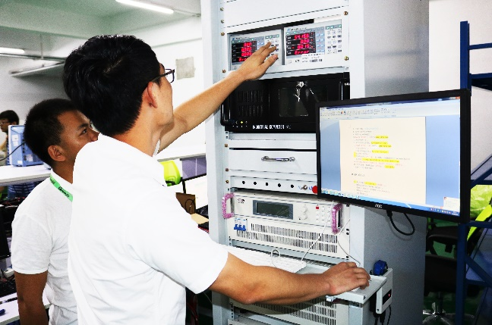
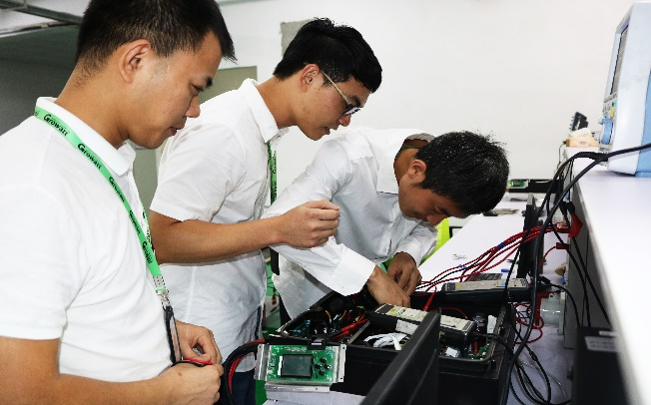
Equipe de P&D
200+ Engenheiros de P&D
R&D
Strength
60%+ 15 anos de experiência
70+ Patentes
10%+ Investimento P&D
Intertek , TUV Certified Lab
Notes:
Our strong R&D team always sticks to the technical innovation to provide customer with premium products and service through its core PV inverter technology, and rigorous quality.
Growatt is a technology-based company and our 10% capital investment is for technological advancements to provide the leading-edge technology solution. Our R&D team consists of over 200 engineers and more than 60% team is well experienced and that excellency leads us to have above 70 patents. We have certified laboratories from Intertek and TUV.
图片更换为更加优秀的图片。

Slide 17
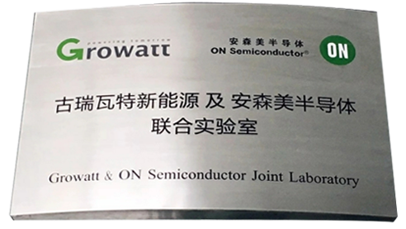
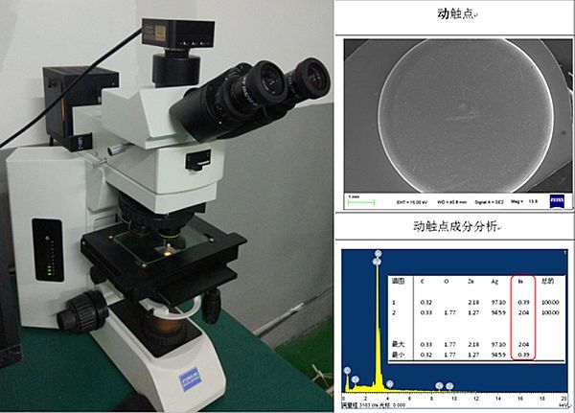
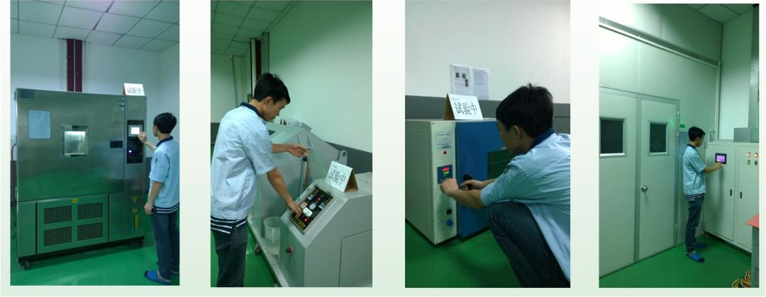
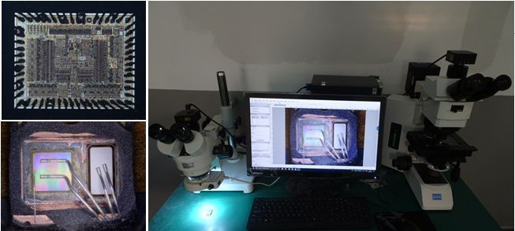
Gerenciamente de confiabilidade do produto
Teste Perfomance & Função
PRM
Teste ambiental & Confiabilidade
Confiabilidade dos componentes
SEM Analysis
Destructive Physical Analysis
Reliability Test
Salt Spray Test
High Temp. Test
Aging Test
Notes:
Our advanced Growatt & ONsemi joined laboratory has a high-tech facility for PRM testing. Every manufactured component needs to pass the performance and function test, environmental and reliability test and component reliability test.

Slide 18
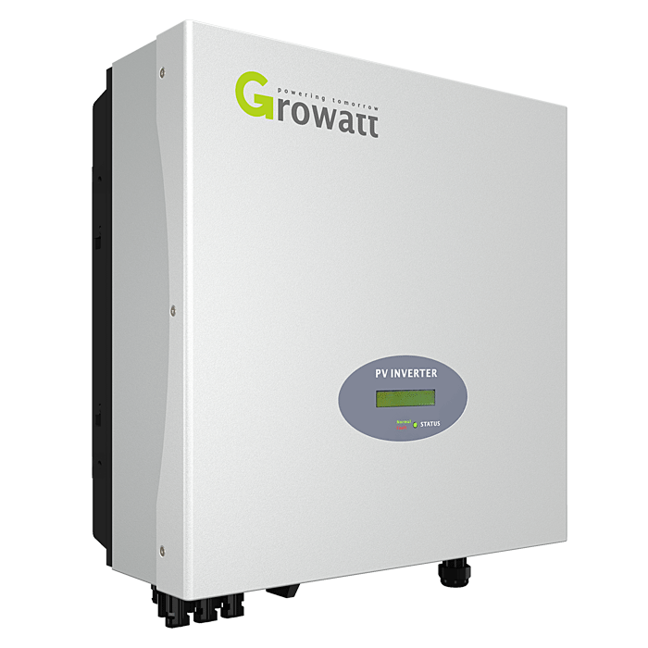
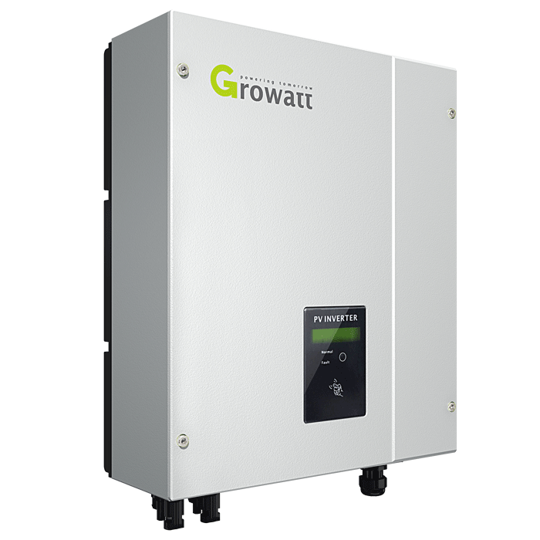
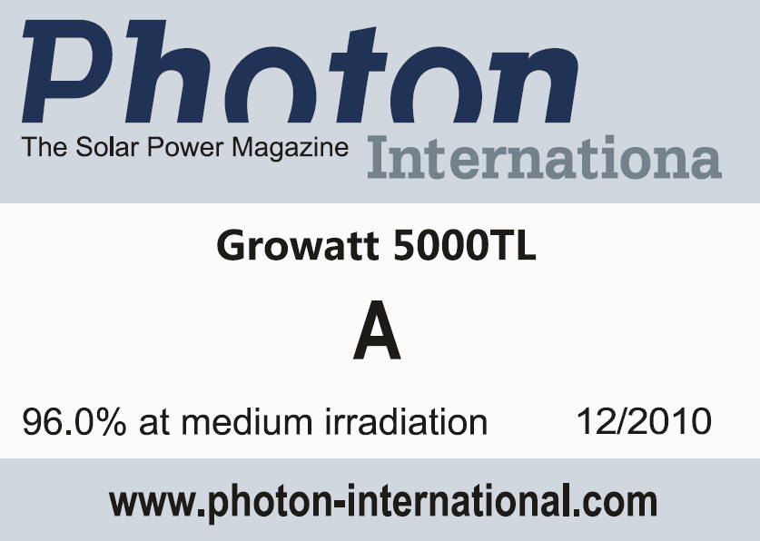

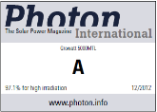
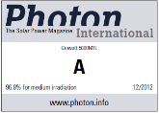
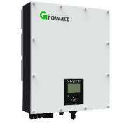
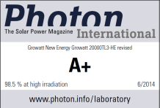
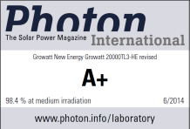
Tecnologia de Ponta
Primeiro inversor a atingir 99% eficiência da indústria
Max Efficiency 99.06%
Double A
2012
A
2010
Double A+
2014
Notes:
In 2010, we got A evaluation from Photon Lab, two years after that, we got double A. With this honor, Growatt continues to work hard and our leading-edge technology keep on progressing. Finally, in 2014, our inverters got double A plus. What’s more, our inverter is the first inverter on the market reaching 99% efficiency.” a 20kw device made by Growatt, the 20k TL-HE is only the second inverter tested by Photon lab to achieve a conversion efficiency higher than 99%, the device scores first place even without silicon carbide transistors ”

Slide 19
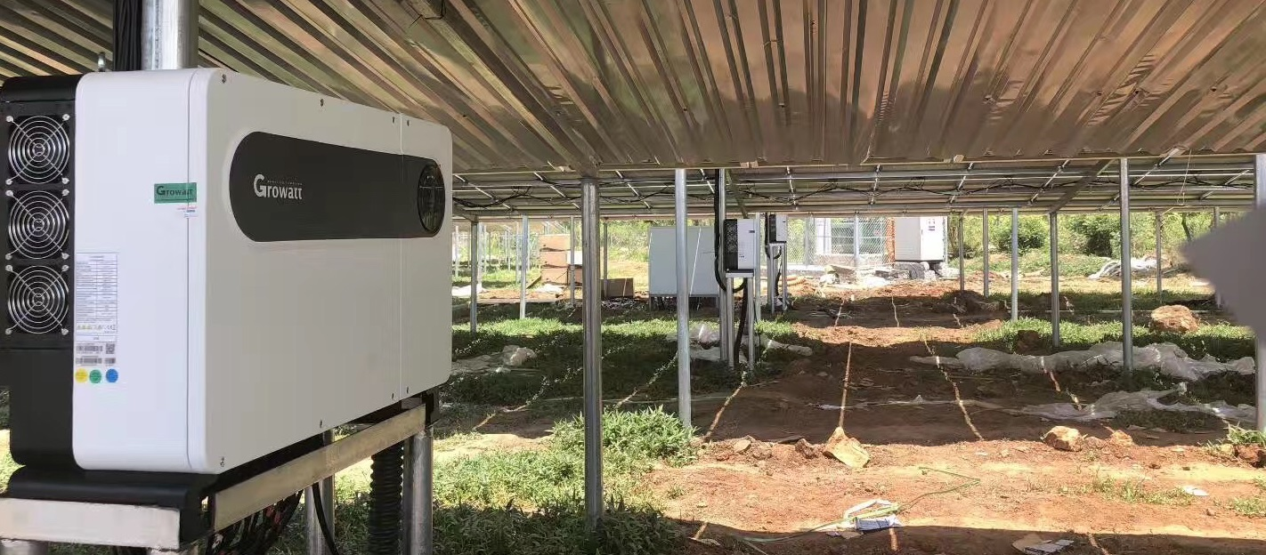
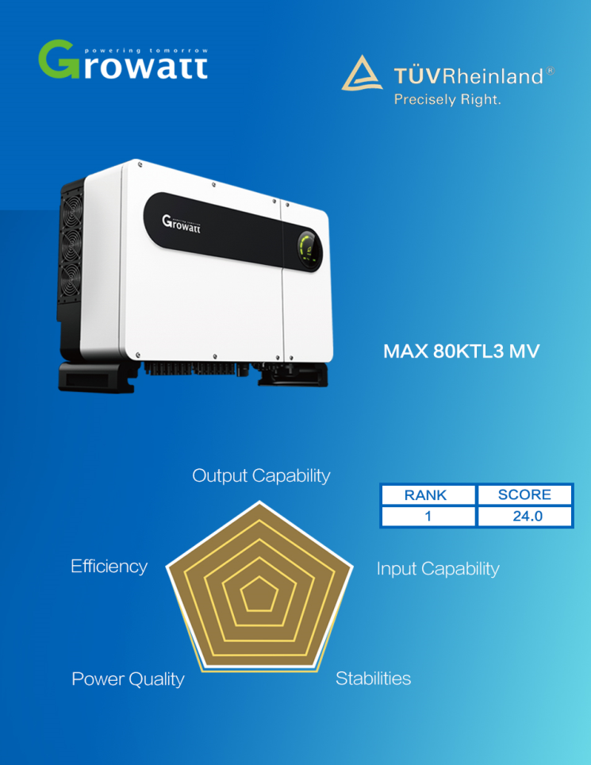
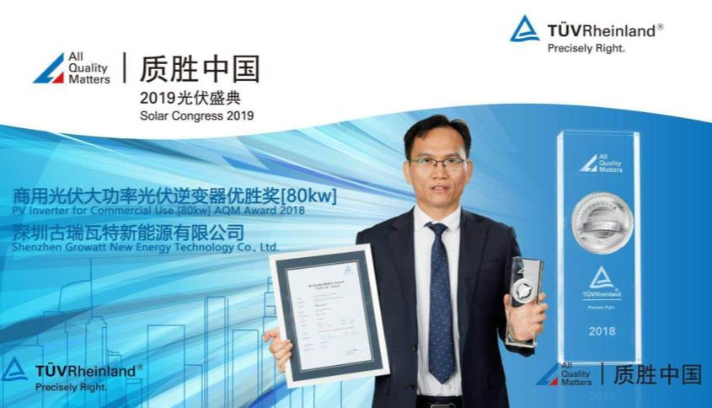
Prêmio da TUV
All Quality Matters Award from TUV Rheinland, Rank No. 1 em inversor comercial.
TUV Award, Solar Congress 2019
All Quality Matter Award
Notes:
With the growing technology, Growatt keeps on progressing and in Solar Congress 2019, we got all quality matter awards for our commercial inverter MAX series and it ranked at No: 1

Slide 20
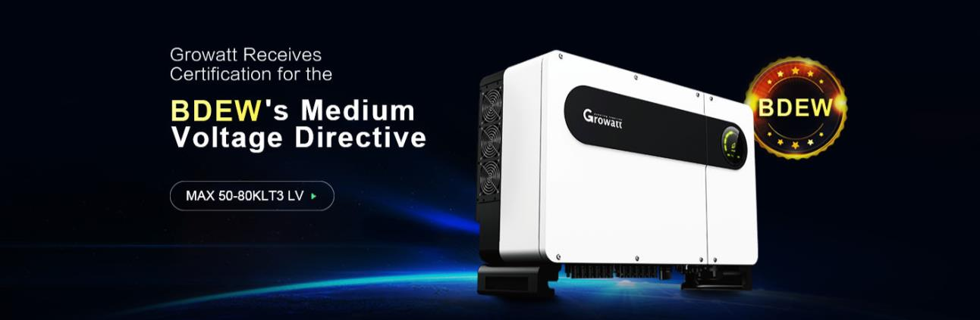
Realização
Growatt entre poucas marcas de inversores asiáticas que receberam o certificado.
Premiada pela Medium Voltage Directive of the German Federal Association for Energy and Water (Bundesverband der Energie- und Wasserwirtschaft na Alemanha, BDEW).
Notes:
With the devotion and engagement with technology, Growatt is among few Asian brands to receive the certification from German BDEW awarded by Medium voltage directive of the German federal association for energy and water.

Slide 21

Avançado centro de manufatura
Recentemente Estabelecido Fábrica com centro maior que 200,000m²
Capacidade de produção anual 10GW.
Notes:
With the motto of powering tomorrow, we have established a advanced manufacturing center with an annual production capacity of 10GW to support the high quality products mass production.

Slide 22
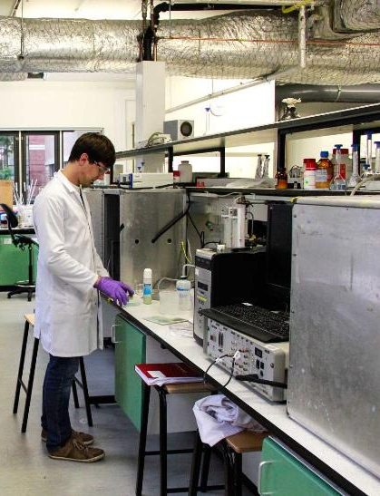















Qualificações de produto
South America
CEI 0-21
0126 N4105
Europe
G98
G99
G100
EN50549
North America
C10/11
TOR 2019
PO12.2 UNE 206007
Australia
Asia
International
LVRT
ZVRT
IEC60068
IEC61683
Notes:
Our product are very well-qualified and have standard certification from different region based on the specific standard of each country.
(请挑重点）
CEI 0-21 --- TÜV Rheinland Italy, Correct connection of users’ plants of LV networks
Enel --- continuous improvement of customer service in Italy
VDE --- TESTING AND CERTIFICATION INSTITUTE conduct tests on safety
BDEW --- Asian inverter brands to receive the certification in accordance with Medium Voltage Directive of the German Federal Association for Energy and Water (Bundesverband der Energie- und Wasserwirtschaft in German, BDEW)
G98 --- UK Grid Certification (systems up to 16A per phase)
G99 --- UK Grid Certification (systems over 16A per phase)
G100 --- (2018) Technical Guidance for Customer Export Limiting Schemes
EN50549 --- Requirements for generating plants to be connected in parallel with distribution networks
C10/11 ---internal specification and parameters are set to be
compliant with BELGIUM
TOR 2019 --- TOR is free and open-source software for enabling
anonymous communication.
FCC --- FCC mark is a certification mark employed on electronic
products manufactured
SAA --- Electrical products entering the Australian market must comply with SAA certification
Clean Energy Council --- CEC is safety and quality standard authority in Australia
LVRT --- Low Voltage Ride Though (LVRT) Testing
ZVRT --- zero-voltage ride through testing
IEC60068 --- It is a collection of methods for environmental testing
of electronic equipment
IEC61683 --- it measures the efficiency of power conditioners used in stand-alone and utility-interactive photovoltaic systems
TUV --- Refers to sampling of the product has been tested safety (German Standard)

Slide 23
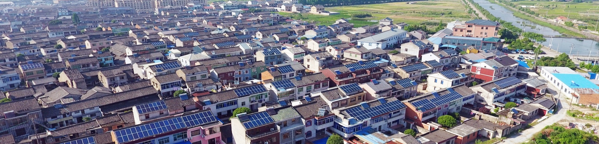
Soluções
3
Notes:
In this part, I’m ready to show you what we can do

Slide 24
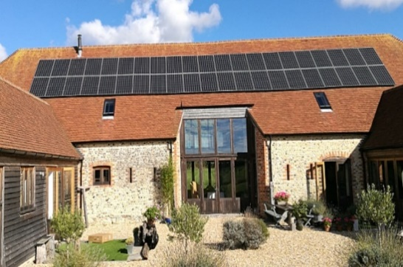
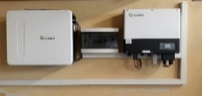
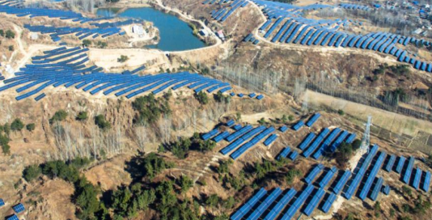
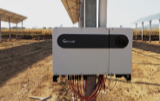
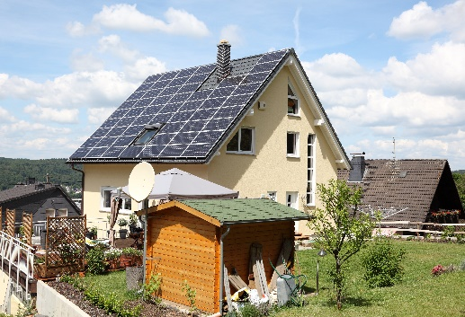
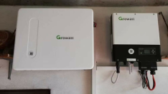
Soluções Oferecidas
Energia de armazenamento
On & Off Grid e Híbridos (Monofásico/Trifásico), Soluções AC-Acoplado.
Growatt é uma nova empresa de energia dedicada a P&D e manufatura de inversores PV incluindo on-grid, off-grid e inversores híbridos, e soluções inteligentes de gerenciamento de energia para o usuário.
C&I
Baixa tensão/Tensão media sistema On-grid (Terrenos acidentados e na cobertura)
Residencial
Monofásicos (0.75~10kW) e trifásicos (3~15kW) , Solução pronta para bacteria e Sistema IoT.
Notes:
First, as we can see, Growatt can supply our customer on-grid, off-grid and energy storage system, the size is from little residential to big utility. In addition, since our aim is to supply smart clean energy for our customer and we do really care about the user-side experience, so, we are now able to supply the smart solution such like IoT system.

Slide 25
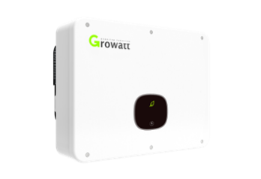
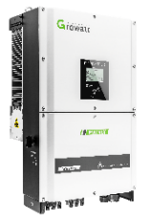
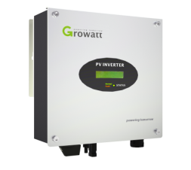
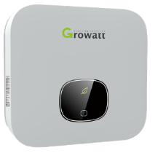
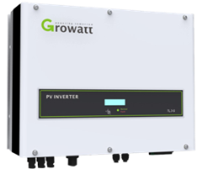
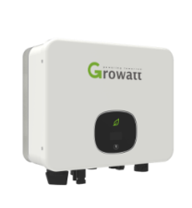
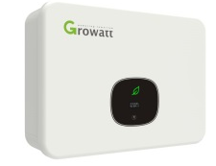
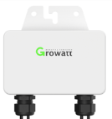
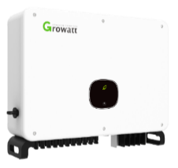
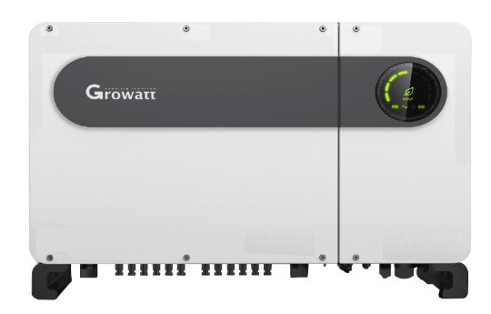
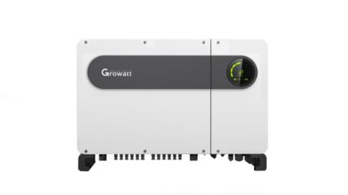
Inversores On-Grid
Comercial & Utility
2019
MID 15-25K TL3-X
17-50K TL3-S/NS
0.75-3K-S
2.5-6K TL-X (XE/XH)
3-15K TL3-S
2019
2020
MIC 0.75-3K-X
3-15K TL3-X
RSD
MAC 40~70K
TL3-X LV/MV
MAX 50~100K
400Vac LV/480Vac MV
Inversores residenciais
MAX 185-253KW@1500Vdc
2020
Notes:
Now is time to see our product. For grid-tied inverters, the residential inverter capacity starts from 0.75~15KW with our recent champion product MIN series (2.5~6 kw) and future product (MIC 0.75~3KW).
For commercial & Utility inverter, it starts from 15KW-100K with our three famous series MID, MAC, MAX. This covers a very wide range of capacity and it is suitable for every kind of customer based on their needs.
Because of our dedication towards the innovative technology and customer-oriented solution, we will lunch our new commercial inverter ranges from 185~250 KW to cover the wide range of users.

Slide 26
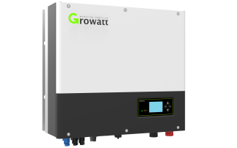
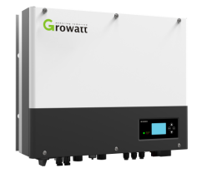
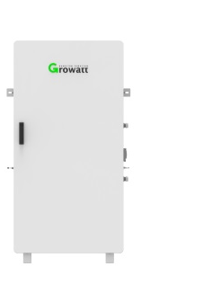
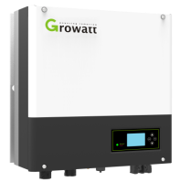
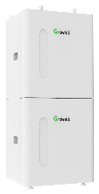
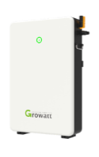

Inversores de Armazenamento
Híbrido
SPH 4-10KTL BH
2020
SPH3-6K / SPH3-6KTL BL (UP)
SPA 1-3K TL BL
All in One
GBLI6531
AC Acoplado
SPA 4-10KTL BH
IES 3000-5000TL BL
H48050
Battery Case
Battery Cabinet
US2000
Bateria
Notes:
For storage inverters, it covers the range of Hybrid inverter (3~10KW) to AC coupled inverter (1~10KW) with the standard batteries for LV and HV. And one of our all in one solution which has battery and inverter inside one cabin to provide a very flexible solution.

Slide 27








Inversores Off-Grid
Accessories
Sem transformador 120 Vac
SPF 5000 ES
SC 4860-48120
MPPT solar charge controller
Transformerless 230 Vac
120 Vac
SPF 3000TL LVM
Battery case/battery
SPF 5000TL HVM-WPV
230 Vac
SPF 4000-6000T DVM
Wi-Fi-F/GPRS-F
SPF 3000-5000TL
HVM
SPF 8000-12000T HVM
T: Low frequency transformer, TL: Transformerless, M: MPPT solar charger controller HV: 230Vac, LV: 120Vac, DV: 120/240Vac, P: Parallel model, WPV: PV 450Vdc model
Com transformador
Notes:
For the off-grid inverter, Growatt inverter capacity varies from the 3k~5k with a transformer to transformer-less topology for 120Vac & 230Vac and it has application for single inverter applications and single/three-phase parallel operation. For accessories, MPPT charge controller, battery storage and Shine WIFI for monitoring and maintenance purposes.

Slide 28








Inversores Residencial
Nova geração de inversores monofásico
MIN 2500-6000TL-X/XH
Elegante, OLED display & Tecla de toque
Compacto e Leve
Tolerância ambiental severa
Type II SPD, AFCI optional
Monitoramento Wifi-F local
*TL-XH é modelo com bateria pronta
Notes:
This is one of our champion single phase inverter product, the power range is from 2.5~6kW with innovative material, and its compact design makes it light and durable. Growatt replaces the traditional LED with an OLED screen, it gives a clear display, longer life span, lower power consumption, and excellent efficiency up to 98.7%. It has a high DC/AC ratio and complete protection such as type II SPD and AFCI, This product is extensively used and already very popular in Australia.

Slide 29



Soluções Comercial & Industrial
MAC 40~70K
TL3-X LV/MV
MAX 50~80K 400Vac LV
MAX 60~100K 480Vac MV
Max efficiency of 98.80%
3 MPPTs/11 to 12 strings
AC/DC Type II SPD
AFCI optional
One click diagnosis
Internal DC switch
BDEW and TUV certified
Up to 6/7 MPPTs/12 to 14 strings
AC/DC type II SPD, string monitor
Anti-PID, AFCI optional
One click diagnosis
Internal DC switch
System Diagram
Notes:
For Commercial & Utility, our core product is with MAC and MAX series.
MAC series has the application range from 40~70KW with an efficiency of 98.8% and supports 3 MPPTs or 11 to 12 strings. It has a high DC/AC ratio and complete protection such as type II SPD and AFCI and its OLED display makes possible one-click diagnosis, in addition, the cost-efficiency is very high.
MAX series has the German certification from BDEW and TUV and it supports 6 to 7 MPPTs or 12 to 14 strings. It also has the same high DC/AC ratio, complete protection for type II SPD and AFCI including its OLED display, it is so smart that it can realized string level monitoring and have the function of one click diagnosis, also there give you anti-PID and AFCI function as option.

Slide 30



Comercial & Industrial
Limitação de exportação e monitoramento de auto-consumo
Iframe para exibir informações do Sistema solar no site.
Notes:
Smart Energy Manager performs the function of Export Limitation as well as Self-consumption monitoring. Based on continuously data monitoring, Smart Energy Manager can set the limitation to zero, 10%, 20%, etc. based on the need to support the self-consumption and monitor it according to the generation from PV (during day, afternoon and at night) and energy export to the grid to meet to load demand.

Slide 31













Utility Solution – 1500V MAX String Inverter
CAPEX
Preparado para uso com CLPs.
Alta sobrecarga DC/AC, até 1.8-2.0
LCOE
15 MPPTs com design sem fusíveis.
Diagnostico de curva I-V inteligente.
Arranjos fotovoltaicos grandes, acima de 6.3MW
Estação base de transmissão
Nuvem
ShineServer
RS485
Sinal de CLP
Terminal de aquisição de dados
ShineMaster
Roteador
ShinePhone
Modulo
…
800V
35kV
Sinal de CLP
Stringbox CA
Transformador 0.8kV/35kV
Grid
Wireless
internet
Modulo
MAX 185-253KTL3 HV
CLP
CC
CA
RS485
Notes:
For Commercial & Utility, our core product is with MAC and MAX series.
MAC series has the application range from 40~70KW with an efficiency of 98.8% and supports 3 MPPTs or 11 to 12 strings. It has a high DC/AC ratio and complete protection such as type II SPD and AFCI and its OLED display makes possible one-click diagnosis, in addition, the cost-efficiency is very high.
MAX series has the German certification from BDEW and TUV and it supports 6 to 7 MPPTs or 12 to 14 strings. It also has the same high DC/AC ratio, complete protection for type II SPD and AFCI including its OLED display, it is so smart that it can realized string level monitoring and have the function of one click diagnosis, also there give you anti-PID and AFCI function as option.

Slide 32
Utility Solution – 1500V MAX String Inverter
Eficiência total de 99%, Eficiência na china de 98.5%
MAX 185-253kW
1500Vcc e 800Vca, reduzindo custos e aumentando eficiencia
9/12/15 MPPT, reduzindo perdas por arranjos incompativeis.
Suporte para modulos bifaciais com corrente de 13A/string
Anti-PID integrado, trazendo mais geração a longo prazo.
Conexões 2 em 1 no lado CC reduzindo custos com cabeamento.
Inversor de string com a maior potencia nominal e o máximo de sobre dimensionamento CC possível do mercado atual.
Suporte para CLPs, reduzindo custos com comunicação.
Possibilidade de compensar reativos à noite, PF ajustavel±0.8
Monitoramento de strings, reduzindo tempo de manutenção.
Notes:
For Commercial & Utility, our core product is with MAC and MAX series.
MAC series has the application range from 40~70KW with an efficiency of 98.8% and supports 3 MPPTs or 11 to 12 strings. It has a high DC/AC ratio and complete protection such as type II SPD and AFCI and its OLED display makes possible one-click diagnosis, in addition, the cost-efficiency is very high.
MAX series has the German certification from BDEW and TUV and it supports 6 to 7 MPPTs or 12 to 14 strings. It also has the same high DC/AC ratio, complete protection for type II SPD and AFCI including its OLED display, it is so smart that it can realized string level monitoring and have the function of one click diagnosis, also there give you anti-PID and AFCI function as option.

Slide 33



Soluções de Armazenamento
Sistema Hibrido
Modelo | SPH 3000-6000 (1 Fase) Europa, Austrália | SPH 3000-6000TL BL-UP Asia, Africa | SPH 4000-10000TL BH (3 Fases)
Potência de carga/descarga | 3kW | 3.6kW, 4kW (10s) | 4-10kW
ATS (Chave de transferência automática) | opcional | Sem necessidade de ATS Tempo de transferência<10ms | opcional
Bateria | 48V | 48V | 120-500V
Notes:
For Energy Storage Hybrid Solution, SPH comes with programmable working modes under grid, PV and storage selection for backup support.
SPH 3K~6K support 2 MPPT and export limitation for its standard configuration.
SPH 4k~10K is a three-phase battery ready solution, it is compatible with the HV battery. Meanwhile, ATS usage can be optional based on the application (if the backup load is necessary to connect).

Slide 34




Soluções de Armazenamento
Sistema CA acoplado
Model | SPA 1000-3000TL BL (1 Fase) Europa, Australia | SPA 4000-10000TL BL (3 Fases)
Potência de carga/descarga | 1-3kW | 4-10kW
ATS | opcional | opcional
Bateria | 48 V | 160~550 V
Notes:
For Energy Storage AC-Coupled Solution, SPA supports the new installation as well as retrofit of the already existing system. It is compatible with the single and three-phase with respect to a different region and its capacity varies accordingly. It is programmed with the different working modes under grid, PV and storage selection for backup support. Similarly, ATS usage can be optional based on the application (if the backup load is necessary to connect).

Slide 35






Solução de Monitoramento e manutenção
Soluções inteligentes
Dispositivos de monitoramento
Plataforma de monitoramento
ShineWiFi-S/GPRS/4G
ShineLink
ShineWiFi-X/RF-X, 4G-X/LAN-X
ShinePhone APP
ShineServer / OSS system
ShineMaster (WLAN/4G)
Notes:
Expect inverter, Growatt also provides a powerful and flexible monitoring devices and platform, with an innovative display which gives a very clear understanding and easy to operate support. Growatt offers a very powerful cloud server with the 10-year（确认） data storage facility and supports the continuous data upload even under the local network outage.

Slide 36



Shine Phone (APP monitoramento)
Informação de produção,
Status do inversor,
Dados da geração, Relatório de evento
Notes:
Through the Shine Phone monitoring APP, a very innovative and user-friendly interface is provided and information like Inverter Datalogger status, inverter data, slef-comsuption and event set the inverter remotely.

Slide 37


Shine Server
Website de monitoramento: http://server.growatt.com/
Informação de produção,
Status do inversor,
dados da geração, Relatório de evento
Notes:
Meanwhile, Shine Server also supports the same features like Shine Phone in computer platform.

Slide 38

Filiais Global
4
Notes:
Now, Let's talk about Our global footsteps in different regions and countries.

Slide 39
Presença Global
14 Filiais, 14 Centro de armazenamento. Inversores instalados em mais de 100 países.
Ruda Śląska
Pecs
Rotterdam
Bangkok
Office
Warehouse
Office
Warehouse
EU HQ
Warehouse
Oxford
Hyderabad
Office
Warehouse
Office
Shenzhen
L.A.
Headquarter
Warehouse
Office
Warehouse
Rome
TaoYuan
Office
Warehouse
Office
Warehouse
Guadalajara
Office
Warehouse
Frankfurt
Office
warehouse
Mogi das Cruzes
Sydney
Office
Warehouse
Office
Warehouse
Notes:
Growatt has established around 14 branch office and 14 warehouse for on time delivery of complete product range, guidance and help of the whole process and for professional local after-sale services to support customer demands.

Slide 40
Growatt Europa
10 Head de vendas
Diretor europeu
Dutch, German, French, Italian, Hungarian, Polish
speaking sales representative.
5 Gerente de produto
Professional technical guidance, system design, product and technical training.
9 Engenheiros de serviço
Remote or onsite O&M service, troubleshooting, provision of spare parts.
5 Escritórios na Europa
50+ Funcionários e Parcerias
Grande equipe de 50 pessoas, 30 localizado na Europa, 20 viaja frequentemente para Europa .
1 Centro de armazenagem em Rotterdam
Notes:
For Growatt Europe, we have around 5 offices and staff members are more than 50 including 10 sales, 5product managers and 9 service engineers.
Also we have 1 warehouse in Rotterdam to support the on-time support.

Slide 41


5 Escritórios na Europa
Growatt Benelux
B.V. Head office and Training Center of Europe
Location: Dalkruidbaan 107，2908KC Capelle aan den ijssel, Rotterdam
Telephone: 085 040 9967
Growatt Italy
Growatt Italy in Rome
Location: Piazza Fernando De Lucia 35/37 – 00139 Roma Telephone:+39 (0)6 88399453/452
Growatt UK
Growatt UK in Oxford
Location: Prama house 267 banbury road, Oxford
Telephone: +44(0)1226 630010
Growatt Hungary
Growatt Hungary in Pécs
Location: 7630 Pécs, Koksz utca 127.
Telephone: +36 208004000
Growatt Poland
Growatt Poland in Ruda Slaska
Location: Klodnicka 56E street, 41-706 Ruda Slaska
Telephone: +48 513 388 399
Notes:
Our branch offices in Europe are in Rotterdam, Italy, UK, Hungary and Poland. The headquarter is Benelux, Rotterdam

Slide 42



Logística
+50MW +20,000 PCS
Stock na Holanda
2-3 dias de entrega em dia útil na Europa.
Notes:
Europe Warehouse in Rotterdam has a capacity of over 50 MW and more than 20,000 pieces in stock for timely support. It's delivery time is around 2 to 3 European working days.

Slide 43









Parceiros de mídia & Treinamento profissional
Indoor
Hungary
Netherland
Notes:
In addition, we have many social media partners in EU, including many famous solar media like PV Europe and PV magazine. Except of product and service support, we also support our customers in marketing.
Every year, in our biggest market, we will arrange this kind professional training for our customers. When this happen, you can come to get a good training.
But don’t worry if you don’t have time to go this training, we can also go to your office to give you a professional training.

Slide 44






Exibições na Europa
Germany
Spain
Sweden
Attend 12+ exhibitions in more than 10 European countries Including Poland Sweden, and Ukraine
8-9 April, 2020 Ukraine
11-12, Dec, 2019, France
29 October 2019, Sweden
Notes:
Here is a quick glimpse of a few Exhibitions in Europe like Spain, Germany, and Sweden. Growatt has attended around more than 12 exhibitions in more than 10 European countries including Poland, Sweden, and Ukraine.
Our recent exhibition were XX in XX on XX . One of our future event will be in XX on XX

Slide 45
Growatt America
Diretor da América
8 Head sales
Um na America do norte
Três no Brasil
4 Gerentes de produto
4 Engenheiros de serviço
Um no México e quatro Brasileiros para o serviço de pós-vendas
1 Escritório no U.S.
1 Warehouse in Mexico
Add: 9227 Reseda Blvd. #435 Northridge, CA 91324.
Add: Guadalajara, Mexico
Line: +52 3314 17 04 25
15+ Equipes e Parcerias
1 Warehouse in Mogi das Cruzes
U.S. Technical Service Line: (818)800-9177
Linha técnica de serviço no Brasil :5511 26104004
Add: Avenida João XXIII, 1160 – Bloco B – Sala 1,
Line:5511 26104004
Notes:
For Growatt America, we have 1 office in the US and staff members are more than 15 and 1 warehouse in Mexico and 1 in Mogi das Cruzes to support the on-time support.

Slide 46









Midias parceiras e Treinamento técnico
São Paulo
Maringá
Notes:
Our Media partner are PV magazine, FuturENERGY, Solar Power World, Energia Estrategica and Greener
We also organized technical meetings and training in Guadalajara & Monterrey to train our installer, distributor, and customer to enhance their PV knowledge.

Slide 47
Growatt Australia
Diretor da Austrália
2 Head sales
1 Gerente de produto
5 Engenheiros de serviço
1 Escritório na Austrália
Add:C1, 27-29 Fariola Street, Silverwater, NSW 2128.
1 Warehouse na Austrália
8 + Equipes e Parcerias
Five local after-sales service engineers , one local sales rep and one pre-sales product engineer
Technical Service Line: +61(0)2 80651298 ,1800 476 928
Add: C1, 27-29 Fariola Street, Silverwater,
NSW 2128 Line: +61(0)2 80651298,1800 476 928
5
Notes:
For Growatt Australia, we have 1 office in the Australia and staff members are more than 8 and 1 warehouse in Australia to facilitate on-time support. Our Australia team is very professional in designing, technical guidance, after-sales services and O&M.

Slide 48






Parcerias de mídia e Treinamento profissional
Melbourne
Adelaide
Notes:
Our Media partner are Clean Energy Council, Smart Energy Council, ecogeneration, Renew Economy.
We also managed technical meetings and training in Melbourne & Adelaide to train our installer, distributor, and customer to enhance their PV knowledge.

Slide 49
Growatt India
Diretor da Índia
3 Head Sales
3 Gerente de produto
8 Engenheiros de serviço
1 Escritório na India
Add: Plot 28, Prashasan Nagar, Road No. 78, Jubilee Hills, Hyderabad, 500033
1 Warehouse in India
20+ Equipes e Parcerias
Eight local after-sales service engineers , three local sales reps, three pre-sales product engineers.
Technical Service Line:1800 120 600 600
Add: Plot 28, Prashasan Nagar, Road No. 78, Jubilee Hills, Hyderabad, 500033
Line:1800 120 600 600
Notes:
For Growatt India, we have 1 office in the India and staff members are more than 20 and 1 warehouse in India to facilitate on-time support.
Our India team is very dedicated to provide technical support and after-sales services.

Slide 50









Media Partner and Professional Trainings
Mumbai
Ahmedabad
Notes:
Our Media partner are Bridge to India, Solar Quarter, RenwableWatch, Mercom, EQ International, SAUR ENERGY and ENERGETICA.
We also structured technical meetings and training in Mumbai & Ahmedabad to distributor, and customer to enhance their PV knowledge.

Slide 51

Serviços & Treinamento.
5
Notes:
Finished our regional Let me introduce you to the services and training that Growatt can offer to our valuable customers.

Slide 52
Atendimento ao consumidor
“
Equipe experiente
Growatt
Treinamento ao cliente
É uma empresa focada no cliente, construimos uma sólida equipe de serviço de pré-venda e pós-venda.
Satisfação do cliente
Serviço de suporte 24 Horas
“
Notes:
Growatt cares about the customer needs and provide them customized services and training based on their demands.
Growatt is a more customer-focused company and built up a pre-sale and after-sale service team for our valuable customers. Our team has experience of more than 15 years and provides 24/7 customer satisfied support to our end-user.

Slide 53

Rede de serviço Global
100%
Equipe professional mundial
260 time com engenheiros de pré-venda e pós-venda, com uma equipe de vendas que cobre o mundo todo.
Para o Mercado externo, a Growatt criou um armazém local para garantir um serviço confiável e eficiente para nossos valiosos clientes.
Nosso suporte técnico esta disponível no modo 24/7.
Notes:
We have established a global professional service network that provide technical support to our valuable customers.
Our team consists of more than 100 pre-sales and after-sales engineers, who are always ready to provide customized support all over the world and we also established local warehouses to ensure reliable and efficient services to our valued clients.

Slide 54

Programa de treinamento Global
Consultoria técnica, Serviços no local, Substituição e reposição de peças.
Online Smart Service OSS
Treinamento O&M
SHINE ELITE
Integre & gerencie plantas e dispositivo facilmente. Mais de 4000 sistemas integrados ou usando a plataforma online com diagnósticos que reduz os custos de O&M.
Equipe qualificada para dar treinamento de O&M globalmente para instaladores e distribuidores para melhorar a capacidade e a competitividade do serviço.
Growatt SHINE ELITE é a primeira organização a abrir as atividades de treinamento offline na China. Agora foi expandido mundialmente.
Notes:
Growatt also holds a recognized Global Training Program, which is more customer-focused including Online Smart Service, Operation and Maintenance Training and Shine Elite.
Our Global training program provides Technical Consultation, Onsite Services, Replacement, and spare parts support.

Slide 55









Online Smart Service (OSS)
Diágnóstico de falha online
Configuração remota de parâmetros
Customer Service
Atualização remota de firmware
More Products
Service Promotion
Visita local desnecessária
24*7 verificação online do status de trabalho de mais de 400,000 inversores conectado ao servidor da Growatt mundialmente e informando a equipe de serviço para prosseguir caso alguma falha seja encontrada.
Information Center
Reduz os custos de manutenção
Notes:
Our Online Smart Service support includes Online failure reporting, Remote parameter setting, remote firmware upgrading and reduces maintenance cost.
More than 400,000 inverters are connected with the Growatt server and they are 24/7 under monitoring by our experienced team to process the after-sales support under any kind of abnormalities.

Slide 56


O&M Treinamento
Soluções de Problema inclui,
Formulários de garantia e RMA
Erros e avisos
FAQ
Monitoramento inclui,
Visão geral do produto
Solucionar problemas
FAQ
Text here
Soluções de problema.
Monitoramento
Notes:
O&M training includes the support for troubleshooting and monitoring of our inverters.
This training provides support for error & warning and also guide of taking action under different kind of situations like No AC connection, AC voltage outrange, programmed the wrong country, etc. Further, a very comprehensive discussion about customer issues and how to tackle them.
Monitoring --- This supports starts from the overall product overview and what actions need to be taken under different situations and faults types than a detailed discussion over Frequently Asked Questions (FAQ).

Slide 57




Growatt Shine Elite
Shine Elite organizou mais de 30 treinamentos todo ano para espalhar o conhecimento, compartihar e trocar experiências da indústria PV.
Até o momento, o evento se fez presente em mais de 40 cidades pelo mundo e ensinou mais de 8000 profissionais.
Nossa plataforma oferece suporte ao distribuidor para que seja treinado a sua equipe de vendas e técnicas.
Austrália
Índia
Brasil
Notes:
Growatt Shine Elite platform is designed to offer support for our distributors to train their sales and technicians and it has already been organized around more than 30 offline trainings to spread and exchange the PV knowledge. Till now, it has covered over 40 cities in the world and already provides training to more than 8000 professionals.

Slide 58

Referências Globais
6
Notes:
Here is the list of our some global references.

Slide 59


Growatt 40000TL3-NS Henan, China
100MW Foxconn Hill Solar Farm
Notes:
100MW Foxconn Hill solar farm in Henan, China has installed 40KTL3-NS series of inverter.

Slide 60


Growatt 20000TL3-HE EA, Thailand
90MW Solar Farm
Notes:
90MW solar farm in Thailand has installed 20KTL3-HE series of inverter.

Slide 61

Growatt 40000TL3-NS Guangdong, China
52MW solar plant owned by Galanz Group
Notes:
52MW solar plant owned by Galanz Group, Guangdong, China has installed 60KTL3-NS inverter.

Slide 62


MAX 60KTL3 LV Gansu, China
10MW Ground Solar Plant
Notes:
100MW Ground Solar Plant in Gansu, China has installed MAX 60KTL3 LV inverters.

Slide 63



136 x 50KTL3-S & 39 x MAX 70KTL3 MV, China
9.65MW, Min County, Gansu
Notes:
9.65 MW solar farm in Gansu, China has installed 136 Pcs of 50KTL3-S and 39 Pcs of MAX 70KTL3 inverters.

Slide 64


Plant Owned by Kirloskar (60K-HE ), India
5.5MW Solar Plant
Maharashtra
Notes:
5.5MW solar plant owned by Kirloskar in India has installed 60K-HE inverter.

Slide 65


Growatt 40000TL3-NS, Thailand
5MW Solar Farm
Notes:
5MW solar farm in Thailand has installed 40K TL3-NS inverter.

Slide 66


Growatt 20KTL3-HE X 200 PCS, India
4MW Solar Plant Chevella, Hyderabad
Notes:
4MW solar plant in Hyderabad India has installed 200 Pcs of 20KTL3-HE inverter.

Slide 67


Growatt 100 x 40KTL3-NS, China
4MW Solar Plant, Anhui
Notes:
4MW solar plant in Anhui has installed 100 Pcs of 40KTL3-NS inverter.

Slide 68


Growatt 36 x MAX 80kW, Vietnam
3MW Solar Farm,
Ninh Thuan
Notes:
3MW solar farm in Vietnam has installed 36 Pcs of MAX 80KTL3 inverter.

Slide 69


93 x 30KTL3-S & 27 x 11KTL3-S, Maldives
3MW Solar Farm
Notes:
3MW solar farm in Maldives has installed 93 Pcs of 30KTL3-S and 27 Pcs of 11KTL3-S inverter.

Slide 70


Growatt 40000 NS x 21 Units, Thailand
1MW Solar rooftop
Owner by SPM
(Ratchaburi)
Notes:
1MW solar rooftop own by SPM in Thailand has installed 21 Pcs of Growatt 40K NS inverter.

Slide 71


Growatt 5000TL HVM-WPV, Minaçu, Brazil
7.035KW Solar Rooftop
Notes:
600KW solar rooftop in Hongkong has installed 15 Pcs of MAX 40KTL3 inverter.

Slide 72


MAX 80 KTL3 installed at BBMB, India
Power House New Delhi
Notes:
Power House New Delhi, India has installed MAX 80 KTL3 at BBMB

Slide 73


Growatt 15pcs MAX 60KTL3 LV, Netherlands
1MW Solar Rooftop
Notes:
1MW solar rooftop in Netherland has installed 15 Pcs of MAX 60KTL3 LV inverter.

Slide 74


MAX 60KTL3 LV Dalfsen, Netherlands
500KW Solar
Rooftop
Notes:
500KW solar rooftop in Netherland has installed MAX 60KTL3 LV inverters in Dalfsen.

Slide 75






Growatt Instalou 17GW de capacidade de inversores.
Notes:
Growatt has already installed the 12GW capacity of solar inverter globally.

Slide 76






Mais de 50,000 Sistemas residenciais de armazenamento
Notes:
Similarly, more than 40,000 Residential Storage Inverter has already been installed world-wide.

Slide 77



Mais de 1,200,000 Sistemas PV residenciais no mundo.
Notes:
Since we are the top3 residential inverter supplier, now more than 1,000,000 Residential PV Systems Worldwide are from Growatt
In the last, I want to say thank you for your listen, together with Growatt, let’s create a green new world!

Slide 78



www.ginverter.com.br
Copyright© 2019 Growatt New Energy Technology CO., LTD All Rights Reserved. The information contained in this document is only for reference purpose and subject to change by company officials.

